Slide 1
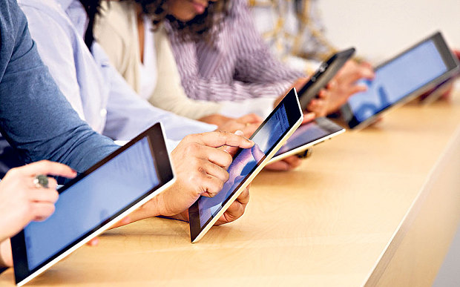
INF1520:Human Computer Interaction
Welcome to this module on human-computer interaction (HCI). We hope that you will find it interesting and stimulating.
INF1520 Human-Computer Interaction is a module that will broaden your horizons to understand why pages/systems are designed in the way that they are and how they should be designed.
This module focuses on enhancing the quality of the interaction between humans and machines and to systematically apply our knowledge about human purposes, capabilities, and limitations as well as machine capabilities and limitations.

Slide 2
  Overview
The module INF1520 is about Human-Computer Interaction (HCI). The study of HCI is done to determine how we can make computer technology more usable for people. The overall purpose of the module is to:
Enhance the quality of the interaction between human and machine by systematically applying our knowledge about the human purpose, capabilities, and limitations as well as about machine capabilities and limitations
develop or improve productivity and the functionality, safety, utility, effectiveness, efficiency, and usability of systems that include computers (Preece et al 2007; Preece et al 2014)
Outcomes
On completing of this module, you should have a knowledge and an understanding of:
the history of human-computer interaction and its current status
the differences between users and designers
the perceptual, cognitive and physical characteristics of computer users
factors such as culture, personality and age that may influence the design and usability of software especially in organisations
typical mistakes designers make and guidelines and principles to address these
the different types of interfaces that computer systems can have
techniques to evaluate interactive systems
the impact of computers on society

Slide 3
Lesson Tool 1: Introduction to Human-Computer Interaction
Computer /software -> designed for people, therefore they should be designed in a way that allows the intended user to use them successfully for the intended purpose and with the least amount of effort.
To design a successful system, designers must:
Know how to support tasks the user will perform with it
Understand:
  ▪ Why users need the system
  ▪ What tasks they will want to perform with system
  ▪ What knowledge they might have (or lack) that may influence interaction with system
  ▪ How the system fits into user’s existing context
Human-computer interaction (HCI)
Adopted in mid-1980s
To denote a new field of study concerned with studying and improving effectiveness and efficiency of computer use.
HCI became a domain of cognitive science research in 1970s – idea was to apply cognitive science methods to software development
Sources that could be used to guide design:
▪ Perception
▪ Motor activity
▪ Problem solving
▪ Language and,
▪ Communication
Human perception, information processing, memory and problem-solving are some of the concepts from cognitive psychology that are related to people’s use of computers.

Slide 4
The Historical Context
The Internet, World Wide Web and Social Networks
The Internet is a global network of billions of computers and other electronic devices. With the Internet, it's possible to access almost any information, communicate with anyone else in the world, and do much more.
The demand and use of internet is increasing world wide. Since in the 1960’s
Two major developments based on the internet are
Electronic mail systems (e-mail): Before 1980s: Email was mostly for academic communities, colleges & universities
World Wide Web (WWW) :Originated from National Centre for Supercomputer Applications (NCSA) at University of Illinois & CERN, the European Research Centre for Nuclear Physics. The Web plays an important role in the functioning of society, infrastructure (transport system) and industries and has managed to integrate into practically every form of social life, and used in technological processes and resources.
The early history of computing can be traced back to the narrow aims of mathematicians, logicians, and astronomers who had particular calculations that needed to be performed.
  The Middle Ages
  The Eighteenth and Nineteenth Century
  The Early Twentieth Century
  The Mid-Twentieth Century
  Turning Points
-1976: Apple's First Personal Computer Kits
-1981: IBM’s First Personal Computer
-1982: The Xerox Star

Slide 5
Social Networks
▪ Social network is a social structure that connects individuals (or organisations).
Connections based on concepts such as friendship, kinship, common interest, financial exchange, dislike, or relationships of beliefs, knowledge or prestige.
Facebook- a social networking website – started in 2004 (Mark Zuckerberg)
Facebook issues includes:
  banned in several countries because it is used to spread political propaganda.
  companies block their employees from accessing Facebook to prevent them from spending time on the network during working hours.
Twitter a social networking and microblogging service that enables its users to communicate through tweets – started in 2006( Jack Dorsey).
Mobile Computing
Is a set of IT technologies, products, services, operational strategies and procedures that enable users to gain access to computation, information and related resources while mobile
It has made internet access an integral part of everyday life through devices such as notebook computers, personal digital assistants (PDAs) such as the iPhone, and standard cell phones.
A mobile computing device is any device that is created using mobile components such as mobile hardware and software.
  Portable and capable of operating, executing and providing services and applications similar to a typical computing device.
Two types of wireless access services:
Wi-Fi - uses radio waves to broadcast an Internet signal from a wireless router to the immediate surrounding area.
Cellular broadband technology - involves a cellular modem or card to connect to cell towers for Internet access. Also make it possible to provide internet access through cell phones and PDAs. Depends on the model of phone and on the type of contract with the service provider.

Slide 6
Current context : Aspects of computer use currently affect HCI
Distributed systems
Development of innovative user interfaces is increasing access to distributed information sources. Internet not only for programmers.
Multimedia interfaces
Text most significant form of interaction with computer systems.
Problem with integrating text into graphical, video and audio information sources
Advanced operating systems
Increasing demands made upon processing resources by graphical and multimedia styles of interaction.
HCI development environments
To of the new generations of interface development software
Environments extend graphical interaction techniques of Apple and Windows desktops to construction of the interface itself.
As a result users be able to customise working environment
Ubiquitous computing (UbiComp)
Refers to computer systems embedded in everyday objects and have unobtrusively become part of the environment.
E.g. Control systems found in a modern car – wiping speed when rain detected
Mobile technology
The use of mobile devices such as mobile phones in substitute of pc’s technologically , anywhere anytime
Gaming
Computer games - most popular products of software industry
HCI Games group conducts research in ICT, design, psychology and HCI-related area

Slide 7
Future Directions - Mobile and ubiquitous computing will remain the focus areas of the future.
The changing notion of ‘the interface’
▪ Outdated ideas of interface will not apply in the era of ubiquitous computing.
▪ GUI and mouse - increasingly be replaced by tangible interfaces controlled by touch, speech and gesture & input mechanisms using eye movement and brain activity will become common.
Increasing dependency on technology
▪ Younger generations are highly dependent on the use of technology
Problem - losing skills previous generation developed (i.e. memorising)
Hyper-connectivity
▪ Communication technology will continue to improve and allow more forms of connectivity among people
▪ Impacts way we relate to people, make friends and how we maintain relationships.
▪ Communication etiquette is changing.
▪ Connectivity levels blurred boundaries between work and leisure space / time
Changes in the means of and reasons for recording information
▪ Information previously stored in pupils memory are now recorded digitally
▪ Cameras and video recording capabilities allow recording activities that would previously be forgotten.
▪ Replacement of handwritten letters by e-mails - easier to build archives of everyday communications.
▪ Increase in recorded information requires improved systems for managing storage and accessing information.
Increased creativity through technology
▪ Increasingly, accessible and flexible computing devices support new ways of playing, learning and creating.
▪ They become tools that can augment human cognition by visualising complex data or processes or by processing huge amounts of information in short periods of time.

Slide 8
Three identified technical challenges for the next decade:
Producing satisfying and effective internet interaction on high-speed (broadband) and slower (dial-up and some wireless) connections.
▪ Although a great deal of research has been done to reduce the file size of images, music, animation and even videos, more needs to be done.
▪ Newer technologies need to be developed to enable pre-fetching or scheduled downloads.
Enabling access to web services on large displays (1200x 1600 pixels or larger) and small mobile devices (640 x 480 and smaller).
▪ Designers need to design web pages for different display sizes to produce best quality - costly and time-consuming
▪ Newer software tools needed to allow website designers to specify content in a way that enables automatic conversations for an increasing range of display sizes.
Supporting easy maintenance of or automatic conversation to multiple languages.
▪ Commercial companies can expand markets if provide access in multiple languages and across various countries.
DENITIONS OF HCI (pg.16)
A ‘set of processes, dialogues, and actions through which a human user employs and interacts with a computer’ (Baecker and Buxton, 1987)
A ‘discipline concerned with the design, evaluation, and implementation of interactive computing systems for human use and with the study of major phenomena surrounding them. Focus is on interaction between one or more humans and one or more computational machines. o Direct interaction involves dialogue with feedback & control during performance of the task.
Indirect interaction involves background / batch processing.
HCI is the study of people, computer technology and the ways these influence each other. ‘Human’ user = whoever is trying to do something using the technology (individuals, groups…) ‘Computer’ = any technology (general / embedded computers, process control systems… ‘Interaction’ = any communication between a user and the computer.
HCI is concerned with studying and improving the many factors that influence the effectiveness and efficiency of computer use It combines techniques from psychology, sociology, physiology, engineering, computer science, and linguistics.

Slide 9
Several other terms and fields of study that has a strong connection with HCI
Ergonomics • is the study of work
Traditionally involved the design of the “total working environment” such as the height of a chair and desk
To design effective user interfaces - consider wider working practices.
Human factors • Describe study of user interfaces in their working context.
• Often used to refer to HCI in context of safety-critical applications
  Addresses the entire person and includes: o Physiology ▪ Physical characteristics such as height and reach
  Perception ▪ Ability to sense information - hearing, touching, seeing
  Cognition ▪ Way we process data such as information
Usability
• International Standards Organisation (ISO) “Extent to which a product can be used by specified users to achieve specified goals with effectiveness, efficiency and satisfaction in a specified context of use”.
  The ISO standard 9241 component definitions:
  Effectiveness ▪ The accuracy and completeness with which specified users can achieve specified goals in particular environments.
  Efficiency ▪ The resources expended in relation to the accuracy and completeness of goals achieved.
  Satisfaction ▪ The comfort and acceptability of the work system to its users and other people affected by its use.

Slide 10
User experience -Refers to how people feel about a product.
How satisfied are they when using it, looking at it, or handling it?
Includes overall impression and how good it feels to touch.
“You cannot design a user experience; you can only design for user experience”
Interaction design -“Designing interactive products to support the way people communicate and interact in their everyday and working lives”.
Involves four activities, namely:
Identifying needs and establishing user requirements
Developing alternative designs according to the requirements
Building prototypes of designs so they can be assessed
Evaluating the designs and the user experience
Accessibility -Designing products so that people with disabilities can use them.
Makes user interfaces perceivable, operable, and understandable by people with a wide range of abilities and people in a wide range of circumstances, environments, and conditions.
Also benefits people without disabilities, and organizations that develop accessible products
Some people see accessibility as a subset of usability
Others, regard it is a prerequisite for usability.

Slide 11
WHO IS INVOLVED IN HCI ?
HCI is a multidisciplinary or interdisciplinary field of study.
The ideal designer of interactive systems should have expertise in a variety of topics:
Psychology and cognitive science - Giving insight into user’s capabilities, and perceptual, cognitive, and problem-solving skills
Environmental factors and ergonomics -To be able to address the user’s working environment, physical capabilities and comfort factors
Organizational factors - To be able to address training, job design, productivity, and work organization
Health and safety factors
Philosophy, sociology, and anthropology -To help understand the wider context of interaction.
Linguistics.
Computer science and engineering -To be able to build the necessary technology
Graphics design - To produce effective interface presentation
Note: No person, not even the average design team, has so much expertise. In practice, designers tend to be strong in one aspect or another. It is, however, not possible to design effective interactive systems from one discipline in isolation.

Slide 12
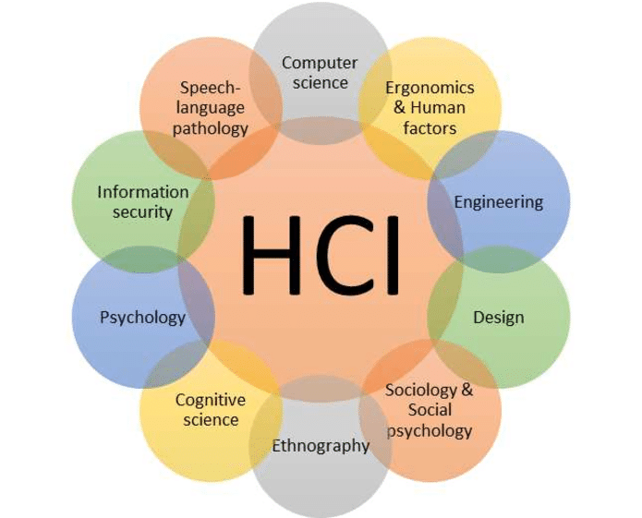
Conclusion
Purpose of studying HCI
Improve quality of interaction between human and machine by systematically applying knowledge about both human and machine capabilities and limitations
To improve the productivity, functionality, effectiveness, efficiency, and usability of technology
Create an awareness of user-centred design
The end of lesson one!!

